Slide 1
COUNSELLO
AI Based Counselor at your rescue

Slide 2
The problem
Lockdown
Personality
Virtual Friend
Staying at home all day, away from friends and school/ colleges affect the mental health of students. An increase in the number of Depression and Stress cases were found recently due to lockdown.
There are very few reliable options when it comes to psychometric evaluations to predict personality traits. Users also seek personalised advice based on their persona
Sure we do have Siri and alexa, but when we feel low, we need someone to share what we feel or what we are going through, and expect it to resolve our issues, by providing personalised solution

Slide 3
Counsello Features
Feature 1
Feature 2
Challenge 3
AI Powered Psychometric Evaluation
Counsello asks a set of 50 Questions, selected from research standard databases. Our AI model, then classifies the user based on his/her answers
AI Powered Emotional Analysis
In addition to Psychometric Evaluation, Counsello also monitors facial emotions, during test and Emotional analysis report is generated
Chat Bot and UI
Counsello has easy-to-use User Interface, with all important information available on the tips. Counsello also supports an A.I. Powered Chat Bot to help stressed and depressed people.

Slide 4
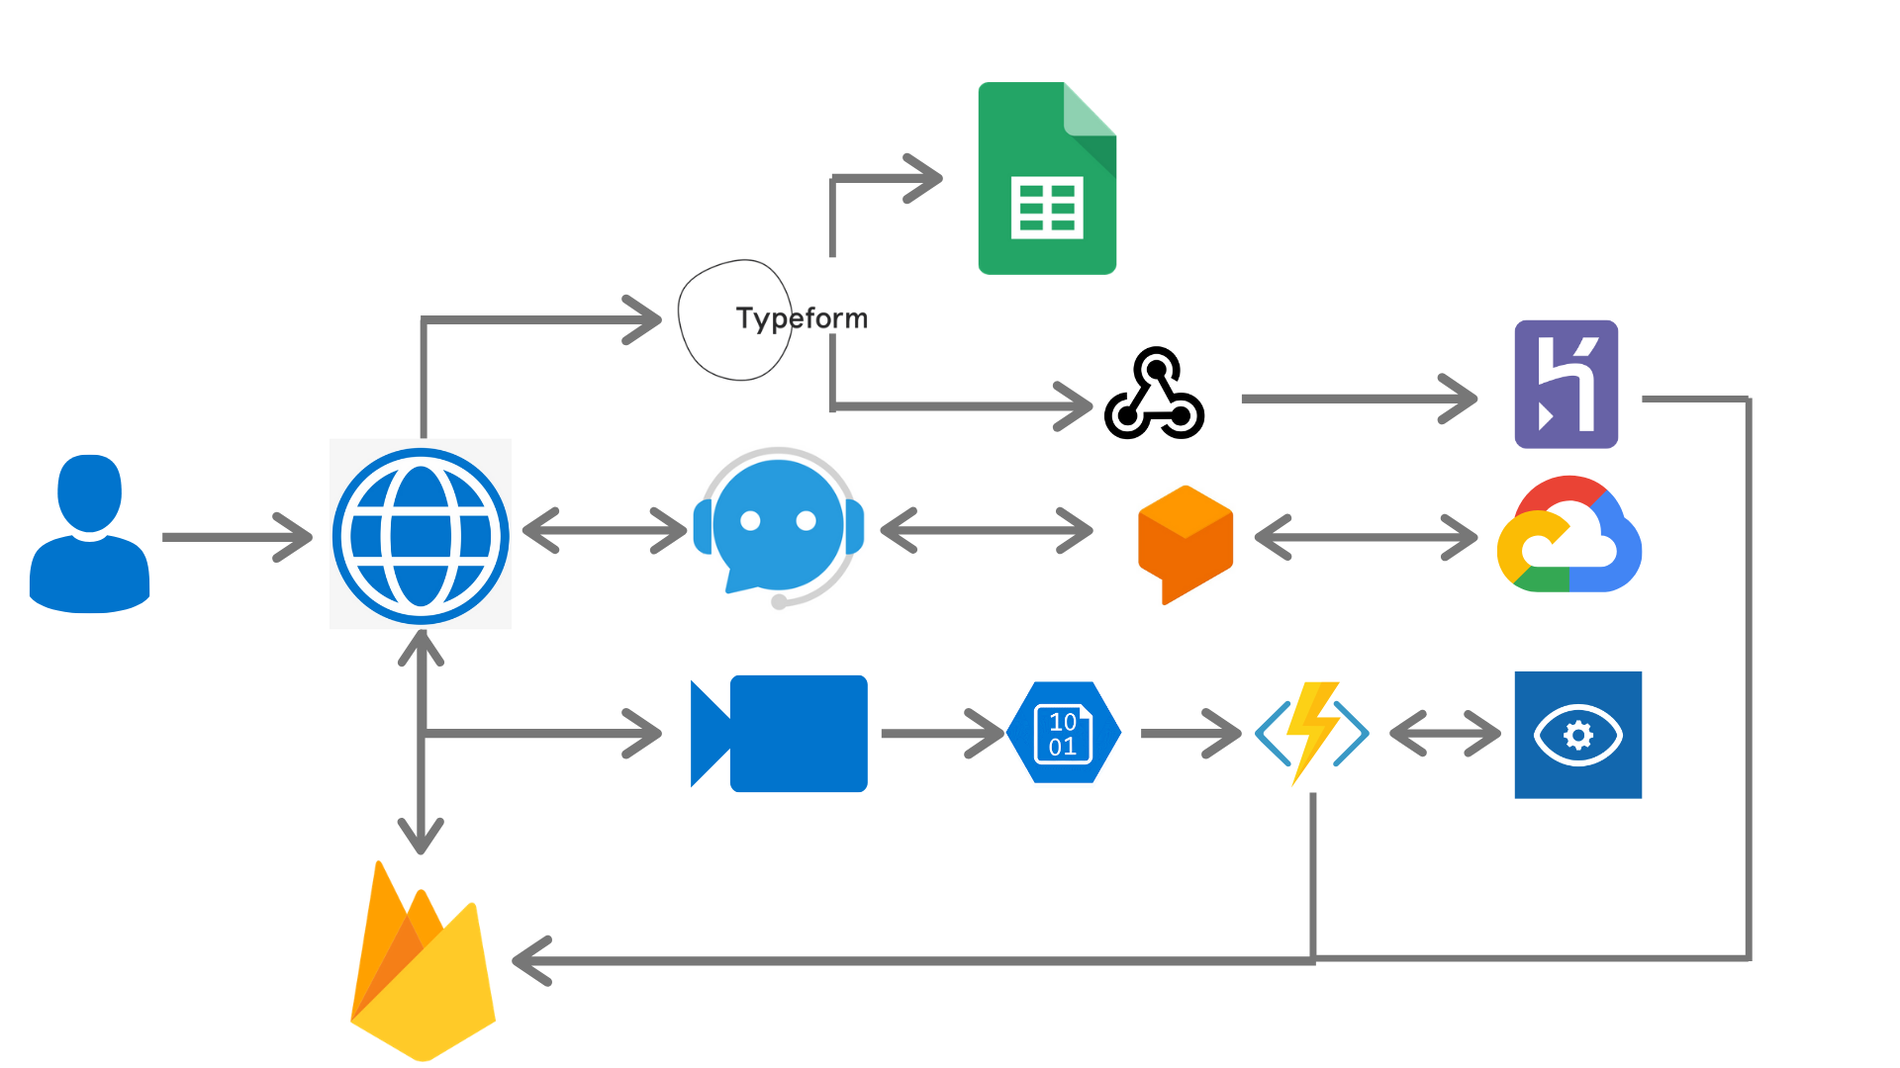
Counsello Implementation

Slide 5
Applications
Upcoming Features
Usable as an advanced Psychometric Evaluation, saved results can be shared with user, schools, colleges and organizations
Usable as an Counsellor in Schools, Colleges, Offices etc
Personal Personality trait check
A Chatbot to whom people can talk and share problems with
Deployment of Azure Face Vision Service for Emotional Analysis
More Questions
More Personality Traits
Better Chatbot
Improved UI/UX
Cost Optimised Solutions

